Slide 1
Microsoft Excel
PRESENTED BY: NANDANI

Slide 2


Introduction
Microsoft Excel is a powerful spreadsheet application used to organize, analyze, and visualize data. It is widely used in businesses, schools, finance, engineering, and research for tasks such as calculations, data management, reporting, and decision-making.

Slide 3

Features of Excel
Worksheets and workbooks
Rows, columns, and cells
Formulas and functions
Charts and graphs
PivotTables
Conditional formatting

Slide 4
Excel Interface
Title Bar
Ribbon
Quick Access Toolbar
Formula Bar
Name Box
Worksheet Area
Sheet Tabs

Slide 5
Basic Components
Workbook
Worksheet
Cell
Row
Column
Range

Slide 6
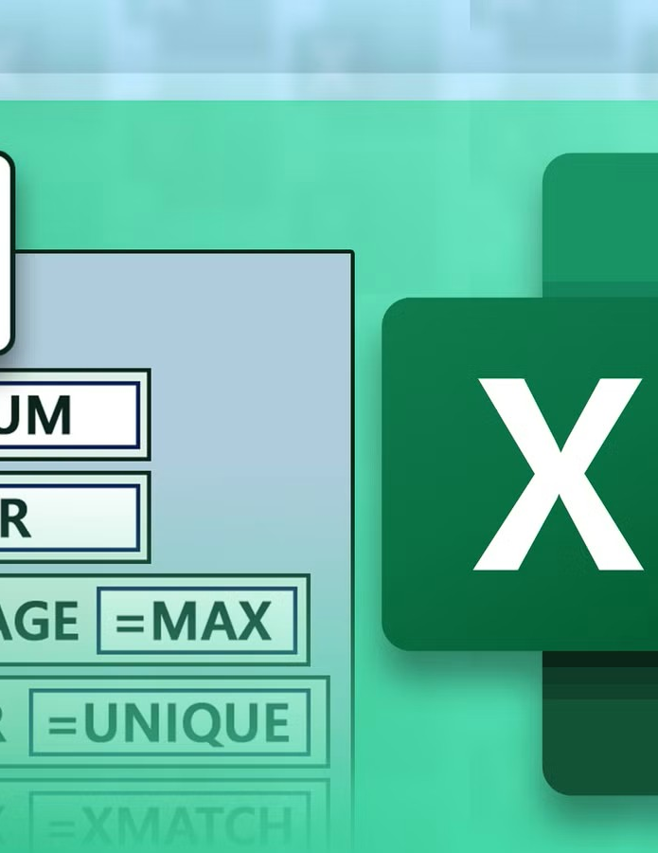
Formulas and Functions
Formula basics
Common functions:
SUM()
AVERAGE()
COUNT()
MAX()
MIN()
IF()

Slide 7
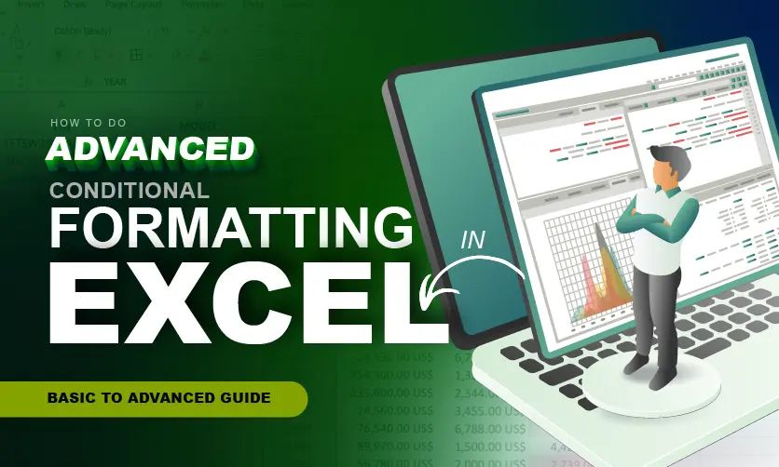
Formatting in Excel
Font formatting
Cell colours
Borders
Number formats
Alignment

Slide 8
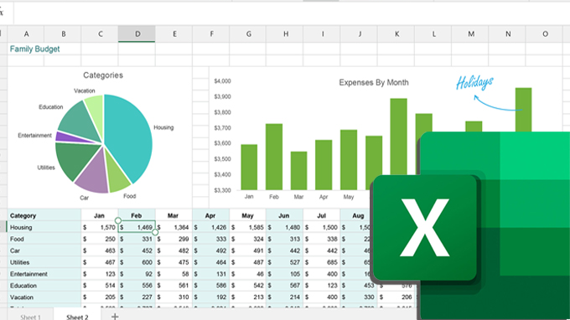
Charts in Excel
Column Chart
Bar Chart
Pie Chart
Line Chart
Area Chart

Slide 9
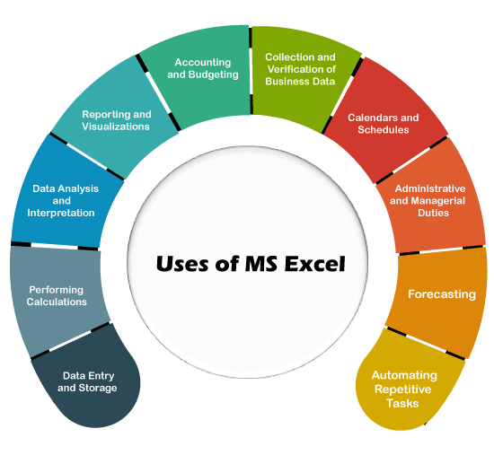
Applications of Excel
Budgeting
Payroll
Inventory management
Student records
Sales reports
Data analysis

Slide 10
Advantages of Excel
Easy to use
Fast calculations
Data organization
Powerful analysis tools
Professional reporting

Slide 11

Limitations of Excel
Not ideal for very large databases
Prone to manual data-entry errors
Collaboration can be challenging without cloud features

Slide 12
Conclusion
Summary of key points
Importance of Excel in education and business

Slide 13


